Slide 1
Oblivious Transfer Extension
涂新宇
Standard OT:
Random OT:
m₀, m₁
OT
c m_{c}
m₀, m₁
OT
c, m_{c}
s, {q }
IKNP
r
i
{t_{i} }

Slide 2
Brief introduction of Oblivious Transfer

Slide 3
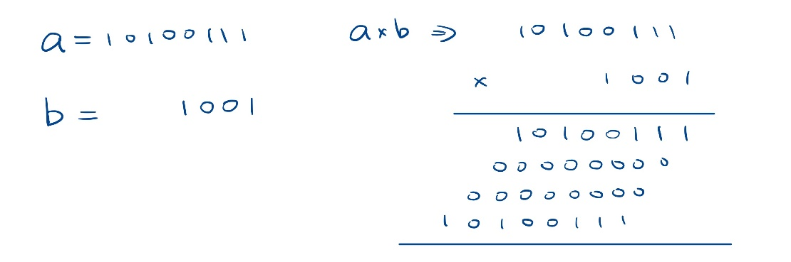
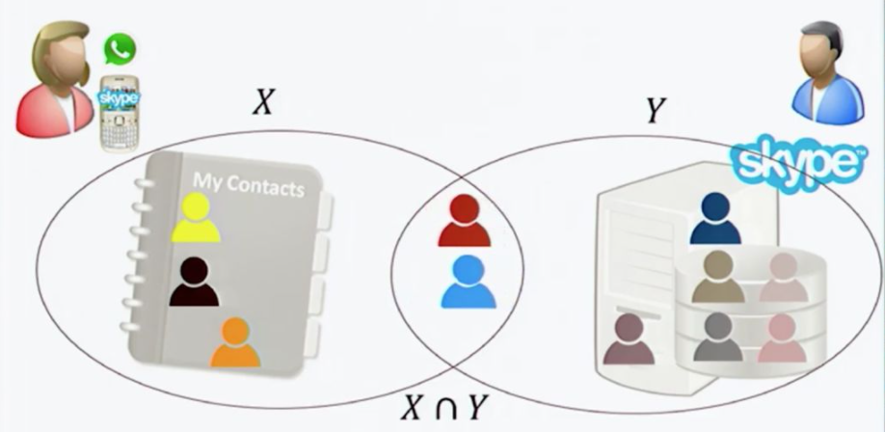
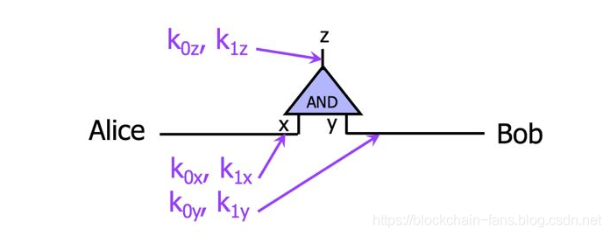
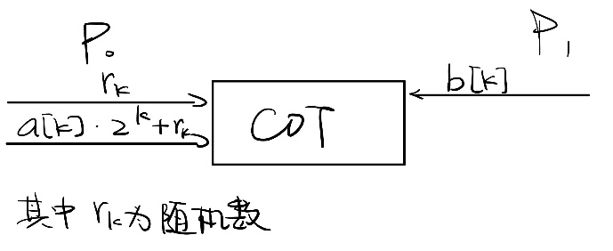
Usage of Oblivious Transfer
Private Set Intersection, PSI
Multiplication Triplets
Garbled Circuit
…
Notes:
PSI
COT计算乘法三元组
GC用选择比特获得对应的key value

Slide 4
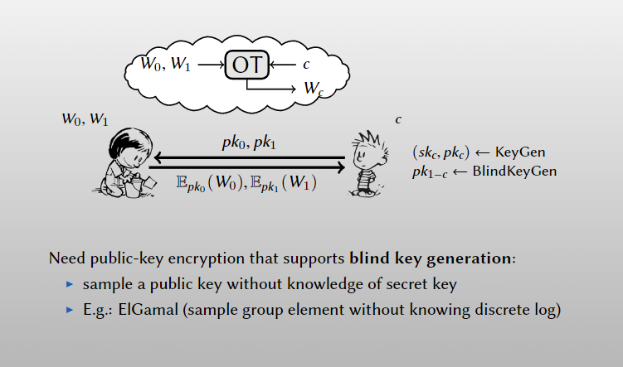
Oblivious Transfer
Notes:
传输方有两字符串w0, w1需要传输，在接收方给定选择比特c后，接收方能够获得对应选择比特的信息wc。该协议基于公钥加密，要求该加密方式能够在不知道私钥是什么的情况生成一个公钥，典型的方式为离散对数，即DH假设

Slide 5
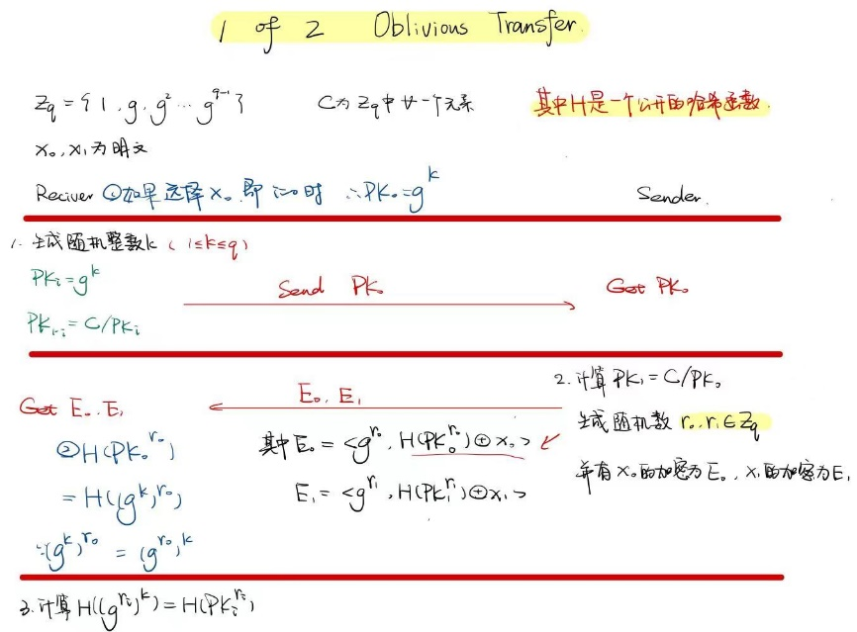
Oblivious Transfer
Notes:
回顾上一张ppt我们需要一种公钥加密方式能够在不知道私钥是什么的情况生成一个公钥，在此我们基于DH进行Oblivious Transfer的简单推导，首先我们需要一个循环群Z_q，其中q表示该循环群中有q个元素，根据群中任意两元素之积仍在群中我们可以知道：任意元素的整数次方仍然在群内。
C是循环群Z_q中的任意元素，H为两方都知道的公开哈希函数

Slide 6
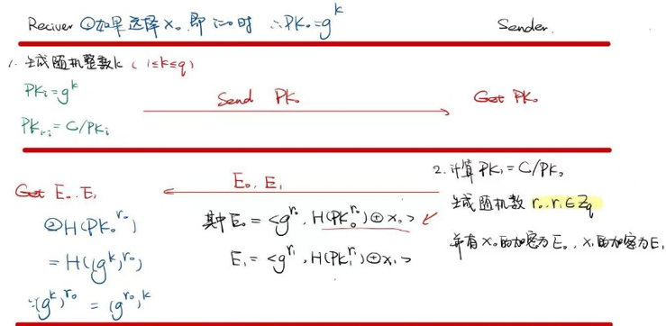
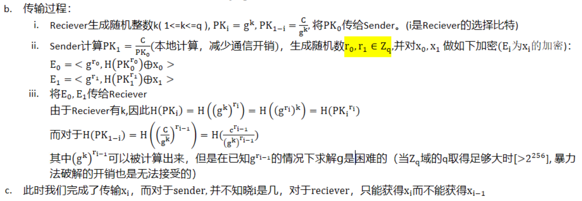
Notes:
由于循环群的性质，我们可以因此获得一对公私钥，其中C为Zq中任意元素，生成公钥PK_i, PK_i-1，由于群的性质保证任意元素的逆元在群内，且任两个元素的乘积也在群内，易知PK_i和PK_i+1都在群内。

Slide 7
OT recap
OT is . . .
Necessary for MPC [Kilian]
Inherently expensive: impossible using only cheap crypto (random oracle) [ImpagliazzoRudich89]
m₀, m₁
OT
c m
c

Slide 8
OT recap
OT is . . .
Necessary for MPC [Kilian]
Inherently expensive: impossible using only cheap crypto (random oracle) [ImpagliazzoRudich89]
m₀, m₁
OT
c m
c
Today’s agenda: reducing the cost of OT
1
Precomputation: can compute OTs even before you know your input!
2
OT extension: 128 OTs suffice for everything.
1-of-n OT
Notes:
如何抓住恶意的参与方

Slide 9
Random Oblivious Transfer

Slide 10
Random OT
Standard OT:
Random OT:
m₀, m₁
OT
c m_{c}
m₀, m₁
OT
c, m_{c}

Slide 11
Random OT
Standard OT:
Random OT:
m₀, m₁
OT
c m_{c}
m₀, m₁
OT
c, m_{c}
Deterministic functionality; parties choose all inputs
Randomized functionality chooses m₀, m₁, c uniformly.

Slide 12
Random OT
Standard OT:
Random OT:
m₀, m₁
OT
c m_{c}
m₀, m₁
OT
c, m_{c}
Deterministic functionality; parties choose all inputs
Randomized functionality chooses m₀, m₁, c uniformly.
Beaver Derandomization Theorem [Beaver91]
There is a cheap protocol that securely evaluates an instance of standard OT using an instance of random OT.

Slide 13
Random OT
Standard OT:
Random OT:
m₀, m₁
OT
c m_{c}
m₀, m₁
OT
c, m_{c}
Deterministic functionality; parties choose all inputs
Randomized functionality chooses m₀, m₁, c uniformly.
Beaver Derandomization Theorem [Beaver91]
There is a cheap protocol that securely evaluates an instance of standard OT using an instance of random OT.
Offline/online approach to 2PC:
In offline preprocessing phase, generate many random OTs
During online phase, OT inputs are determined — cheaply derandomize the offline OTs with Beaver’s trick.
Notes:
线下：生成许多ROT
线上：利用ROT高效计算OT

Slide 14
Beaver Derandomization [Beaver91]
m$, m$
OT
offline
c$, m$
0 1
_{c}$

Slide 15
Beaver Derandomization [Beaver91]
m$, m$
OT
offline
c$, m$
0 1
_{c}$
m₀, m₁
online
c
m_{c} ?

Slide 16
Beaver Derandomization [Beaver91]
m$, m$
OT
offline
c$, m$
0 1
_{c}$
m₀, m₁
online
c
$
x = m ⊕ m
0
0
0
1
$
x = m ⊕ m
1
1
Idea: Alice can use $m_{0}$$ and $m_{1}$$ as one-time pads to mask m₀, m₁

Slide 17

Beaver Derandomization [Beaver91]
m$, m$
OT
offline
c$, m$
0 1
_{c}$
m₀, m₁
online
c ( = c$)
$
x = m ⊕ m
0
0
0
1
$
x = m ⊕ m
1
1
$
_{c}$
compute x ⊕ m
c
$
= x ⊕ m = m
c
c
c
I d e a: Alice can use $m_{0}$$ and $m_{1}$$ as one-time pads to mask m₀, m₁
If c = c$ this works: Bob can decrypt only m_{c} (no info about m_{1−c})

Slide 18
Beaver Derandomization [Beaver91]
m$, m$
OT
offline
c$, m$
0 1
_{c}$
m₀, m₁
online
c ( ≠ c$)
$
x = m ⊕ m
0
1
0
1
$
x = m ⊕ m
1
0
$
_{c}$
compute x ⊕ m
c
$
= x ⊕ m = m_{c}
c
1⊕ c
I d e a: Alice can use m$ and m$ as one-time pads to mask m₀, m₁
0 1
If c = c$ this works: Bob can decrypt only m_{c} (no info about m_{1−c})
If c ≠ c$ Bob learns wrong m unless Alice swaps m$ , m$.
0 1

Slide 19
Beaver Derandomization [Beaver91]
m$, m$
OT
offline
c$, m$
0 1
_{c}$
m₀, m₁
online
c
d = c ⊕ c$
$
x₀ = m_{d} ⊕ m₀
x₁ = m$ ⊕ m₁
1⊕ d
▶
Idea: Alice can use m$ and m$ as one-time pads to mask m₀, m₁
0
1
▶
▶
If c = c$ this works: Bob can decrypt only m_{c} (no info about m_{1−c})
If c ≠ c$ Bob learns wrong m unless Alice swaps m$ , m$.
Solution: Bob says whether c = c$ (safe: Alice has no info about c$)
0 1
▶

Slide 20
Beaver Derandomization [Beaver91]
m$, m$
OT
offline
c$, m$
0 1
_{c}$
m₀, m₁
online
c
d = c ⊕ c$
$
x₀ = m_{d} ⊕ m₀
x₁ = m$ ⊕ m₁
1⊕ d
$
_{c}$
compute x ⊕ m
c
$
= x ⊕ m = m_{c}
c
c ⊕ d
▶
Idea: Alice can use m$ and m$ as one-time pads to mask m₀, m₁
0
1
▶
▶
If c = c$ this works: Bob can decrypt only m_{c} (no info about m_{1−c})
If c ≠ c$ Bob learns wrong m unless Alice swaps m$ , m$.
Solution: Bob says whether c = c$ (safe: Alice has no info about c$)
0 1
▶

Slide 21
Beaver Derandomization [Beaver91]
m$, m$
OT
d = c ⊕ c$
c$, m$
0 1
_{c}$
x₀ = m$ ⊕ m₀
d
x₁ = m$ ⊕ m₁
1⊕ d
Offline cost: same as before (1 OT instance)
Online cost: simple XORs
Notes:
接下来要解决的问题就是如何生成ROT

Slide 22
Beaver OT extension [Beaver96]
Key insight: Yao’s protocol requires only # of OTs proportional to function’s input length
Beaver protocol: Run the following 2PC using Yao:
s_{A}
Use s_{A} ⊕ s_{B} as pseudorandom seed to:
s_{B} ∈ {0, 1}^{λ}
r, {m_{i, ri} }_{i}
Sample 2n random strings
(m_{1, 0}, m_{1, 1}), . . . , (m_{n, 0}, m_{n, 1}).
Sample n-bit random string r
{mi, b }i, b

Slide 23
Beaver OT extension [Beaver96]
Key insight: Yao’s protocol requires only # of OTs proportional to function’s input length
Beaver protocol: Run the following 2PC using Yao:
s_{A}
Use s_{A} ⊕ s_{B} as pseudorandom seed to:
s_{B} ∈ {0, 1}^{λ}
r, {m_{i, ri} }_{i}
Sample 2n random strings
(m_{1, 0}, m_{1, 1}), . . . , (m_{n, 0}, m_{n, 1}).
Sample n-bit random string r
{mi, b }i, b
# OTs = input length = λ
Output provides n ≫ λ instances of OT (random strings + choice bits)
Impractical feasibility result (2PC evaluation of a PRG circuit)

Slide 24
Yuval Ishai, Joe Kilian, Kobbi Nissim, Erez Petrank:
Extending Oblivious Transfers Efficiently. Crypto 2003.
IKNP Protocol

Slide 25
IKNP protocol [IshaiKilianNissimPetrank03]
r
1
0
0
0
1
0
1
1
.
.
.
Bob
Bob has input r

Slide 26
IKNP protocol [IshaiKilianNissimPetrank03]
r
1 | 1 1 1 1 1 1 1 1
0 | 0 0 0 0 0 0 0 0
0 | 0 0 0 0 0 0 0 0
0 | 0 0 0 0 0 0 0 0
1 | 1 1 1 1 1 1 1 1
0 | 0 0 0 0 0 0 0 0
1 | 1 1 1 1 1 1 1 1
1 | 1 1 1 1 1 1 1 1
. . . | . . . . . . . . . . . . . . . . . . . . . . . .
Bob
Bob has input r ⇒ extend to matrix

Slide 27
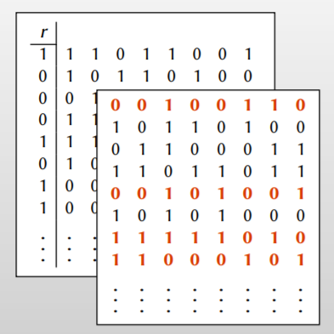
IKNP protocol [IshaiKilianNissimPetrank03]
Bob has input r ⇒ extend to matrix and secret share as (T, T′)
. . . .
. . . .

Slide 28
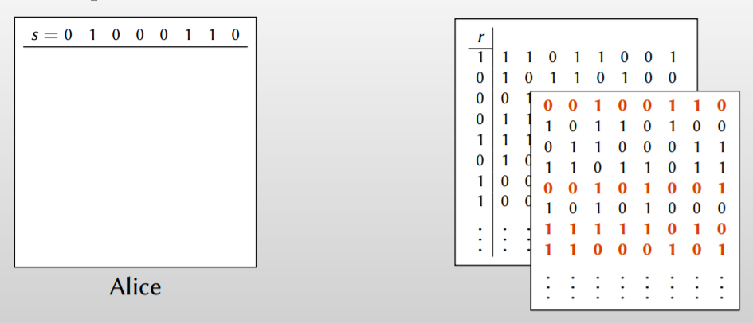
IKNP protocol [IshaiKilianNissimPetrank03]
Bob has input r ⇒ extend to matrix and secret share as (T, T′)
Alice chooses random string s

Slide 29
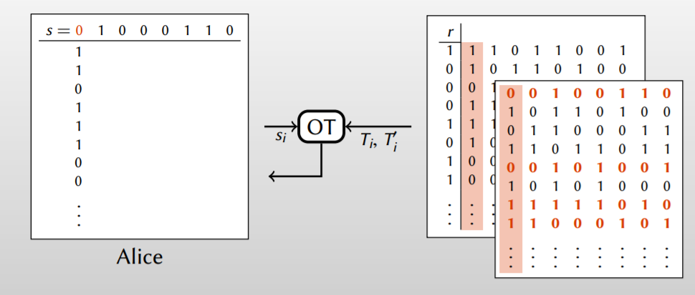
IKNP protocol [IshaiKilianNissimPetrank03]
Bob has input r ⇒ extend to matrix and secret share as (T, T′)
Alice chooses random string s
OT for each column ⇒ Alice obtains matrix Q

Slide 30
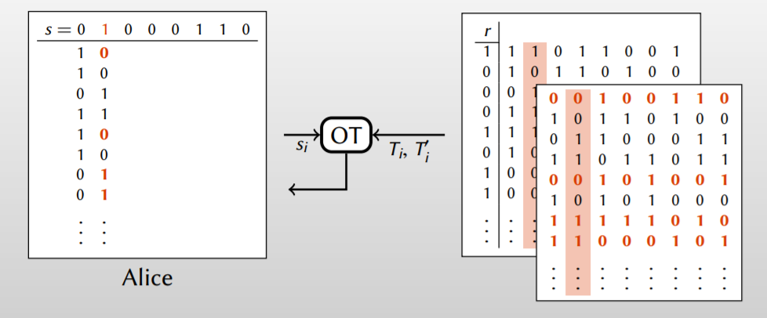
IKNP protocol [IshaiKilianNissimPetrank03]
Bob has input r ⇒ extend to matrix and secret share as (T, T′)
Alice chooses random string s
OT for each column ⇒ Alice obtains matrix Q

Slide 31
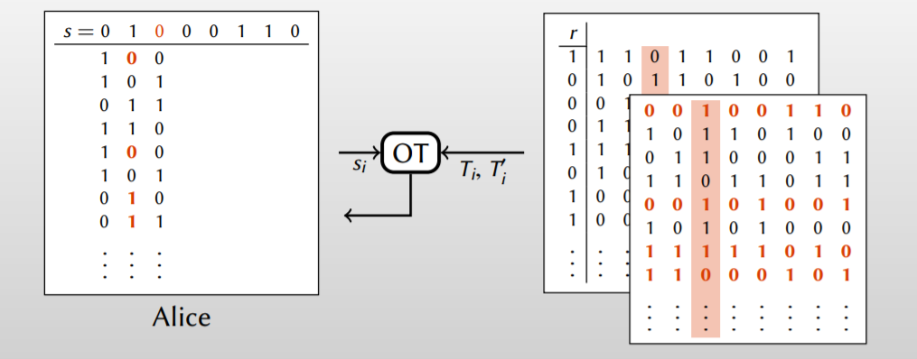
IKNP protocol [IshaiKilianNissimPetrank03]
Bob has input r ⇒ extend to matrix and secret share as (T, T′)
Alice chooses random string s
OT for each column ⇒ Alice obtains matrix Q

Slide 32
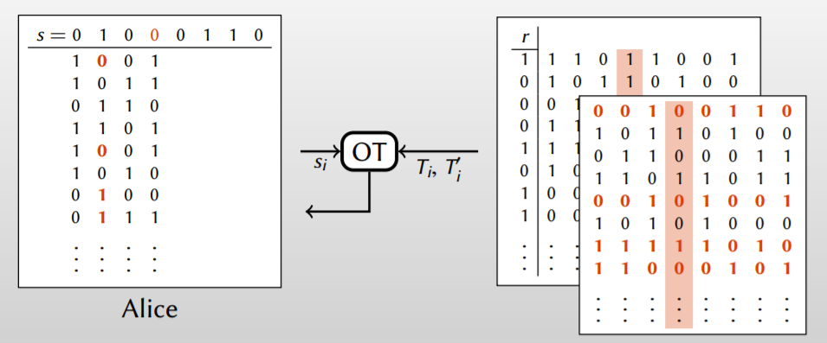
IKNP protocol [IshaiKilianNissimPetrank03]
Bob has input r ⇒ extend to matrix and secret share as (T, T′)
Alice chooses random string s
OT for each column ⇒ Alice obtains matrix Q

Slide 33
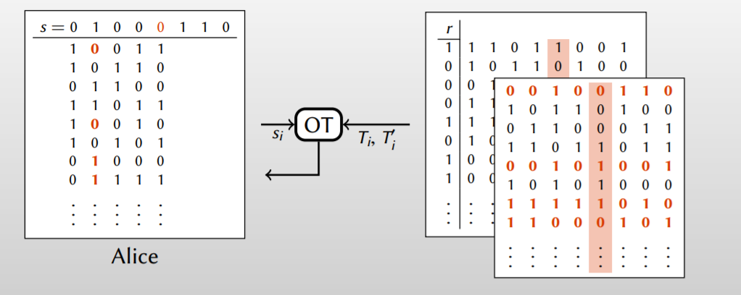
IKNP protocol [IshaiKilianNissimPetrank03]
Bob has input r ⇒ extend to matrix and secret share as (T, T′)
Alice chooses random string s
OT for each column ⇒ Alice obtains matrix Q

Slide 34
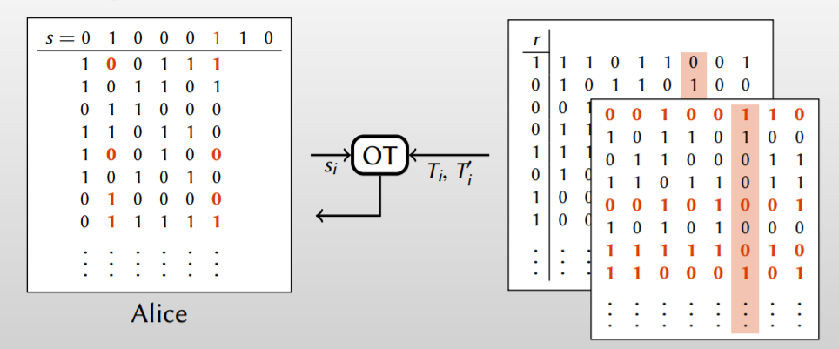
IKNP protocol [IshaiKilianNissimPetrank03]
Bob has input r ⇒ extend to matrix and secret share as (T, T′)
Alice chooses random string s
OT for each column ⇒ Alice obtains matrix Q

Slide 35
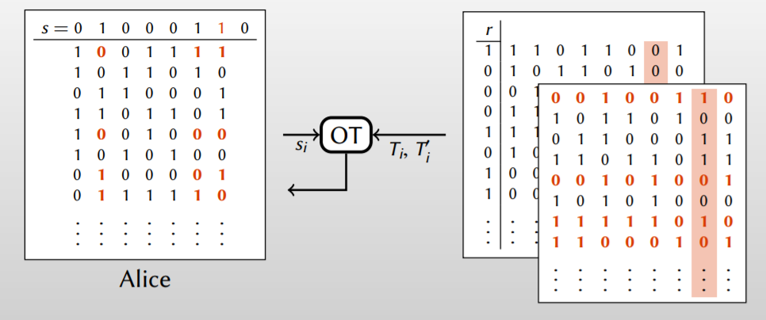
IKNP protocol [IshaiKilianNissimPetrank03]
Bob has input r ⇒ extend to matrix and secret share as (T, T′)
Alice chooses random string s
OT for each column ⇒ Alice obtains matrix Q

Slide 36
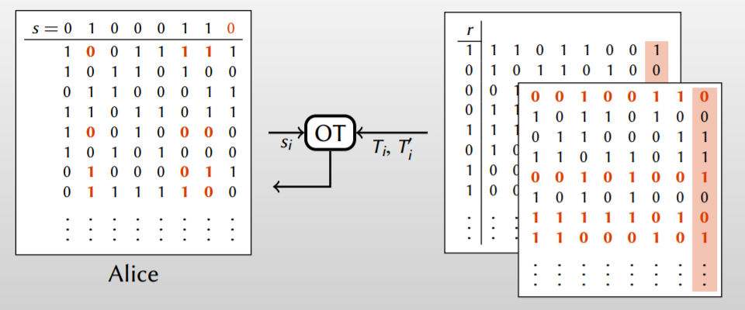
IKNP protocol [IshaiKilianNissimPetrank03]
Bob has input r ⇒ extend to matrix and secret share as (T, T′)
Alice chooses random string s
OT for each column ⇒ Alice obtains matrix Q

Slide 37
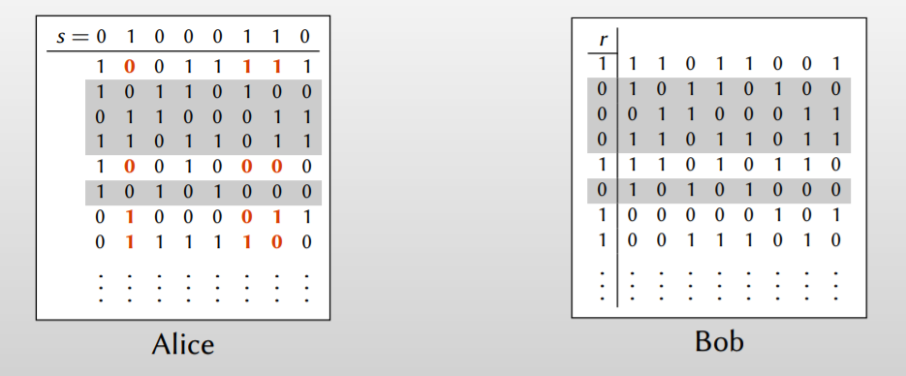
IKNP protocol [IshaiKilianNissimPetrank03]
Bob has input r ⇒ extend to matrix and secret share as (T, T′)
Alice chooses random string s
OT for each column ⇒ Alice obtains matrix Q
Whenever r_{i} = 0, Alice row = Bob row

Slide 38
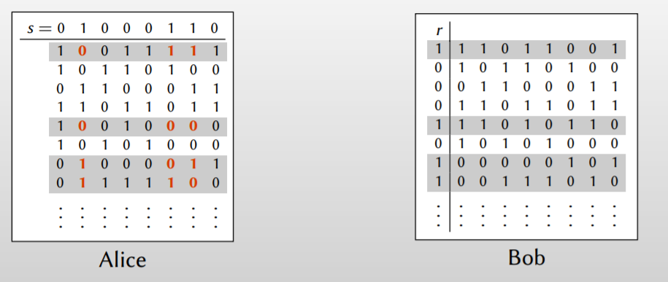
IKNP protocol [IshaiKilianNissimPetrank03]
Bob has input r ⇒ extend to matrix and secret share as (T, T′)
Alice chooses random string s
OT for each column ⇒ Alice obtains matrix Q
Whenever r_{i} = 0, Alice row = Bob row
Whenever r_{i} = 1, Alice row = Bob row ⊕ s

Slide 39
IKNP protocol [IshaiKilianNissimPetrank03]
s, {q_{i} }
IKNP
r
{t_{i} }

Slide 40
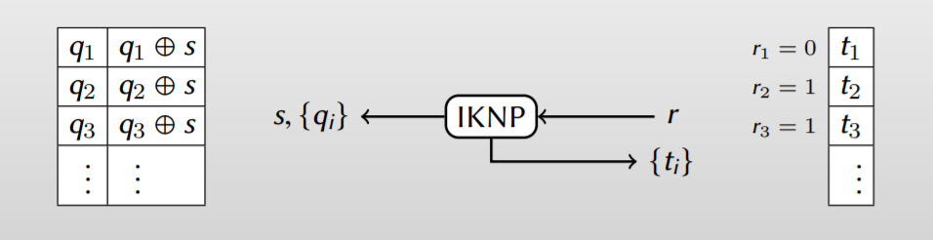
IKNP protocol [IshaiKilianNissimPetrank03]
For every i: Bob knows t_{i}; Alice knows q_{i} and q_{i} ⊕ s

Slide 41
IKNP protocol [IshaiKilianNissimPetrank03]
{
t if r_{i} = 0
q =
i
i
t_{i} ⊕ s if r_{i} = 1
t₁ | t₁ ⊕ s
t₂ ⊕ s | t₂
t₃ ⊕ s | t₃
. | .
r = 0
t₁
t₂
t₃
.
.
1
r₂ = 1
r₃ = 1
s, {q }
IKNP
r
i
{t_{i} }
For every i: Bob knows t_{i}; Alice knows q_{i} and q_{i} ⊕ s
From Bob’s perspective, he knows exactly one of Alice’s two values: (Almost) an OT instance for each i!

Slide 42
IKNP protocol [IshaiKilianNissimPetrank03]
{
t if r_{i} = 0
q =
i
i
t_{i} ⊕ s if r_{i} = 1
t₁ | t₁ ⊕ s
t₂ ⊕ s | t₂
t₃ ⊕ s | t₃
. | .
r = 0
t₁
t₂
t₃
.
.
1
r₂ = 1
r₃ = 1
s, {q }
IKNP
r
i
{t_{i} }
For every i: Bob knows t_{i}; Alice knows q_{i} and q_{i} ⊕ s
From Bob’s perspective, he knows exactly one of Alice’s two values: (Almost) an OT instance for each i!
Reusing s leads to linear correlations in OT strings

Slide 43
IKNP protocol [IshaiKilianNissimPetrank03]
{
t if r_{i} = 0
q =
i
i
t_{i} ⊕ s if r_{i} = 1
H(t₁) | H(t₁ ⊕ s)
H(t₂ ⊕ s) | H(t₂)
H(t₃ ⊕ s) | H(t₃)
. | .
r = 0
H(t₁)
H(t₂)
H(t₃)
.
1
r₂ = 1
r₃ = 1
s, {q }
IKNP
r
i
{t_{i} }
For every i: Bob knows t_{i}; Alice knows q_{i} and q_{i} ⊕ s
From Bob’s perspective, he knows exactly one of Alice’s two values: (Almost) an OT instance for each i!
Reusing s leads to linear correlations in OT strings
Break correlations by applying random oracle:
H(t₁ ⊕ s), . . . H(t_{n} ⊕ s) pseudorandom given t₁, . . . , t_{n} (secret s)
. . . .
. . . .

Slide 44
IKNP protocol [IshaiKilianNissimPetrank03]
t if r_{i} = 0
q =
{
i
i
t_{i} ⊕ s if r_{i} = 1
m1, 0 | m1, 1
m2, 0 | m2, 1
m3, 0 | m3, 1
. | .
r = 0
m1, 0
m2, 1
m3, 1
.
1
r₂ = 1
r₃ = 1
s, {q_{i} }
IKNP
r
{t_{i} }
For every i: Bob knows t_{i}; Alice knows q_{i} and q_{i} ⊕ s
From Bob’s perspective, he knows exactly one of Alice’s two values: (Almost) an OT instance for each i!
Reusing s leads to linear correlations in OT strings
Break correlations by applying random oracle:
H(t₁ ⊕ s), . . . H(t_{n} ⊕ s) pseudorandom given t₁, . . . , t_{n} (secret s)
⇒ Random OT instance for each row, using base OT for each column

Slide 45
1 – of – n Oblivious Transfer

Slide 46
Generalizing IKNP [KolesnikovKumaresan13]
r
1
0
0
0
1
0
1
1
.
.
.
IKNP says: “Bob has r
”

Slide 47
Generalizing IKNP [KolesnikovKumaresan13]
r
1 | 1 1 1 1 1 1 1 1
0 | 0 0 0 0 0 0 0 0
0 | 0 0 0 0 0 0 0 0
0 | 0 0 0 0 0 0 0 0
1 | 1 1 1 1 1 1 1 1
0 | 0 0 0 0 0 0 0 0
1 | 1 1 1 1 1 1 1 1
1 | 1 1 1 1 1 1 1 1
. . . | . . . . . . . . . . . . . . . . . . . . . . . .
IKNP says: “Bob has r ⇒ extend to a matrix
”

Slide 48
Generalizing IKNP [KolesnikovKumaresan13]
r
1 | 1 1 1 1 1 1 1 1
0 | 0 0 0 0 0 0 0 0
0 | 0 0 0 0 0 0 0 0
0 | 0 0 0 0 0 0 0 0
1 | 1 1 1 1 1 1 1 1
0 | 0 0 0 0 0 0 0 0
1 | 1 1 1 1 1 1 1 1
1 . . . | 1 1 1 1 1 1 1 1 . . . . . . . . . . . . . . . . . . . . . . . .
1 | 1 | 0 | 1 | 1 | 0 | 0 | 1
1 | 0 | 1 | 1 | 0 | 1 | 0 | 0
0 | 1 | 1 | 0 | 0 | 0 | 1 | 1
1 | 1 | 0 | 1 | 1 | 0 | 1 | 1
1 | 1 | 0 | 1 | 0 | 1 | 1 | 0
1 | 0 | 1 | 0 | 1 | 0 | 0 | 0
0 | 0 | 0 | 0 | 0 | 1 | 0 | 1
0 | 0 | 1 | 1 | 1 | 0 | 1 | 0
. | . | . | . | . | . | . | .
. | . | . | . | . | . | . | .
0 | 0 | 1 | 0 | 0 | 1 | 1 | 0
1 | 0 | 1 | 1 | 0 | 1 | 0 | 0
0 | 1 | 1 | 0 | 0 | 0 | 1 | 1
1 | 1 | 0 | 1 | 1 | 0 | 1 | 1
0 | 0 | 1 | 0 | 1 | 0 | 0 | 1
1 | 0 | 1 | 0 | 1 | 0 | 0 | 0
1 | 1 | 1 | 1 | 1 | 0 | 1 | 0
1 | 1 | 0 | 0 | 0 | 1 | 0 | 1
. . . . . . . . . . . . . . . . . . . . . . . .
=
⊕
IKNP says: “Bob has r ⇒ extend to a matrix ⇒ secret-share”

Slide 49
Generalizing IKNP [KolesnikovKumaresan13]
 | r 1 | 1 | 1 | 1 | 1 | 1 | 1 | 1 | 1
 | 0 | 0 | 0 | 0 | 0 | 0 | 0 | 0 | 0
 | 0 | 0 | 0 | 0 | 0 | 0 | 0 | 0 | 0
 | 0 | 0 | 0 | 0 | 0 | 0 | 0 | 0 | 0
 | 1 | 1 | 1 | 1 | 1 | 1 | 1 | 1 | 1
 | 0 | 0 | 0 | 0 | 0 | 0 | 0 | 0 | 0
 | 1 | 1 | 1 | 1 | 1 | 1 | 1 | 1 | 1
 | 1 | 1 | 1 | 1 | 1 | 1 | 1 | 1 | 1
 | . . . | . . . . . . . . . . . . . . . . . . . . . . . .
1 | 1 | 0 | 1 | 1 | 0 | 0 | 1
1 | 0 | 1 | 1 | 0 | 1 | 0 | 0
0 | 1 | 1 | 0 | 0 | 0 | 1 | 1
1 | 1 | 0 | 1 | 1 | 0 | 1 | 1
1 | 1 | 0 | 1 | 0 | 1 | 1 | 0
1 | 0 | 1 | 0 | 1 | 0 | 0 | 0
0 | 0 | 0 | 0 | 0 | 1 | 0 | 1
0 | 0 | 1 | 1 | 1 | 0 | 1 | 0
. | . | . | . | . | . | . | .
. | . | . | . | . | . | . | .
0 | 0 | 1 | 0 | 0 | 1 | 1 | 0
1 | 0 | 1 | 1 | 0 | 1 | 0 | 0
0 | 1 | 1 | 0 | 0 | 0 | 1 | 1
1 | 1 | 0 | 1 | 1 | 0 | 1 | 1
0 | 0 | 1 | 0 | 1 | 0 | 0 | 1
1 | 0 | 1 | 0 | 1 | 0 | 0 | 0
1 | 1 | 1 | 1 | 1 | 0 | 1 | 0
1 | 1 | 0 | 0 | 0 | 1 | 0 | 1
. . . . . . . . . . . . . . . . . . . . . . . .
=
⊕
IKNP says: “Bob has r ⇒ extend to a matrix ⇒ secret-share”
KK13 says: 0 ›→ 000 · · · ; 1 ›→ 111 · · · is simple repetition code
Notes:
Repetition code “重复码”

Slide 50
Generalizing IKNP [KolesnikovKumaresan13]
 | r 1 | 1 | 1 | 1 | 1 | 1 | 1 | 1 | 1
 | 0 | 0 | 0 | 0 | 0 | 0 | 0 | 0 | 0
 | 0 | 0 | 0 | 0 | 0 | 0 | 0 | 0 | 0
 | 0 | 0 | 0 | 0 | 0 | 0 | 0 | 0 | 0
 | 1 | 1 | 1 | 1 | 1 | 1 | 1 | 1 | 1
 | 0 | 0 | 0 | 0 | 0 | 0 | 0 | 0 | 0
 | 1 | 1 | 1 | 1 | 1 | 1 | 1 | 1 | 1
 | 1 | 1 | 1 | 1 | 1 | 1 | 1 | 1 | 1
 | . . . | . . . . . . . . . . . . . . . . . . . . . . . .
1 | 1 | 0 | 1 | 1 | 0 | 0 | 1
1 | 0 | 1 | 1 | 0 | 1 | 0 | 0
0 | 1 | 1 | 0 | 0 | 0 | 1 | 1
1 | 1 | 0 | 1 | 1 | 0 | 1 | 1
1 | 1 | 0 | 1 | 0 | 1 | 1 | 0
1 | 0 | 1 | 0 | 1 | 0 | 0 | 0
0 | 0 | 0 | 0 | 0 | 1 | 0 | 1
0 | 0 | 1 | 1 | 1 | 0 | 1 | 0
. | . | . | . | . | . | . | .
. | . | . | . | . | . | . | .
0 | 0 | 1 | 0 | 0 | 1 | 1 | 0
1 | 0 | 1 | 1 | 0 | 1 | 0 | 0
0 | 1 | 1 | 0 | 0 | 0 | 1 | 1
1 | 1 | 0 | 1 | 1 | 0 | 1 | 1
0 | 0 | 1 | 0 | 1 | 0 | 0 | 1
1 | 0 | 1 | 0 | 1 | 0 | 0 | 0
1 | 1 | 1 | 1 | 1 | 0 | 1 | 0
1 | 1 | 0 | 0 | 0 | 1 | 0 | 1
. . . . . . . . . . . . . . . . . . . . . . . .
=
⊕
IKNP says: “Bob has r ⇒ extend to a matrix ⇒ secret-share”
KK13 says: 0 ›→ 000 · · · ; 1 ›→ 111 · · · is simple repetition code
Generalize by using a different error-correcting code.
Q: How do code properties (rate, distance) affect protocol?

Slide 51
Coding view of IKNP:
r
1
0
0
0
.
.
.
Bob
Bob has input r

Slide 52
Coding view of IKNP:
r
1 · · · C(1) · · ·
0 · · · C(0) · · ·
0 · · · C(0) · · ·
0 · · · C(0) · · ·
. .
. .
. .
Bob
Bob has input r ⇒ encode under C

Slide 53
Coding view of IKNP:
r
1 · · · t₁ · · ·
0 · · · t₂ · · ·
0 ·
· · t₃ · · ·
· · t₄ · · ·
.
.
.
Bob
0 ·
· · · t₁ ⊕ C
(1) · · ·
· · · t₂ ⊕ C
(0) · · ·
.
· · · t₃ ⊕ C
(0) · · ·
.
.
· · · t₄ ⊕ C
(0) · · ·
.
.
.
Bob has input r ⇒ encode under C and secret share as (T, T′)

Slide 54

Coding view of IKNP:
· · · q₁ · · ·
r
1 · · · t₁ · · ·
0 · · · t₂ · · ·
0 ·
· · · q₂ · · ·
· · · q₃ · · ·
OT
· · t₃ · · ·
· · t₄ · · ·
.
.
.
Bob
· · · q₄ · · ·
si
Ti, T′_{i}
0 ·
· · · t₁ ⊕ C
(1) · · ·
.
· · · t₂ ⊕ C
(0) · · ·
.
.
· · · t₃ ⊕ C
(0) · · ·
.
.
.
· · · t₄ ⊕ C
(0) · · ·
Alice
.
.
.
Bob has input r ⇒ encode under C and secret share as (T, T′)
OT for each column ⇒ Alice obtains matrix Q

Slide 55
Coding view of IKNP:
· · · q₁ · · ·
r
1 · · · t₁ · · ·
0 · · · t₂ · · ·
0 ·
· · · q₂ · · ·
· · · q₃ · · ·
t_{i} = q_{i} ⊕ C(r_{i}) ∧ s
· · t₃ · · ·
· · t₄ · · ·
.
.
.
Bob
· · · q₄ · · ·
0 ·
· · · t₁ ⊕ C
(1) · · ·
.
· · · t₂ ⊕ C
(0) · · ·
.
.
· · · t₃ ⊕ C
(0) · · ·
.
.
.
· · · t₄ ⊕ C
(0) · · ·
Alice
.
.
.
Bob has input r ⇒ encode under C and secret share as (T, T′)
OT for each column ⇒ Alice obtains matrix Q

Slide 56
Coding view of IKNP:
· · · q₁ · · ·
r
1 · · · t₁ · · ·
0 · · · t₂ · · ·
0 ·
· · · q₂ · · ·
· · · q₃ · · ·
t_{i} = q_{i} ⊕ C(r_{i}) ∧ s
· · t₃ · · ·
· · t₄ · · ·
.
.
.
Bob
· · · q₄ · · ·
0 ·
· · · t₁ ⊕ C
(1) · · ·
.
· · · t₂ ⊕ C
(0) · · ·
.
.
· · · t₃ ⊕ C
(0) · · ·
.
.
.
· · · t₄ ⊕ C
(0) · · ·
Alice
.
.
.
Bob has input r ⇒ encode under C and secret share as (T, T′)
OT for each column ⇒ Alice obtains matrix Q
Sanity check (using repetition code):
r_{i} = 0
r_{i} = 1
⇒ t_{i} = q_{i} ⊕ (000 · · · ) ∧ s = q_{i}
⇒ t_{i} = q_{i} ⊕ (111 · · · ) ∧ s = q_{i} ⊕ s

Slide 57
Coding view of IKNP:
s, {q_{i} }
IKNP
r
{t_{i} }

Slide 58
Coding view of IKNP:
q₁ ⊕ C(0) ∧ s | q₁ ⊕ C(1) ∧ s
q₂ ⊕ C(0) ∧ s | q₂ ⊕ C(1) ∧ s
q₃ ⊕ C(0) ∧ s | q₃ ⊕ C(1) ∧ s
. | .
. | .
r₁ = 0
t₁
r₂ = 1
t₂
s, {q_{i} }
IKNP
r
r₃ = 1 t₃
{t_{i} }
.
.
.
For every i: Bob knows t_{i}; Alice knows q_{i} ⊕ C(0) ∧ s and q_{i} ⊕ C(1) ∧ s

Slide 59
Coding view of IKNP:
t_{i} = q_{i} ⊕ C(r_{i}) ∧ s
t₁ ⊕ C(0) ∧ s ⊕ C(0) ∧ s | t₁ ⊕ C(0) ∧ s ⊕ C(1) ∧ s
t₂ ⊕ C(1) ∧ s ⊕ C(0) ∧ s | t₂ ⊕ C(1) ∧ s ⊕ C(1) ∧ s
t₃ ⊕ C(1) ∧ s ⊕ C(0) ∧ s | t₃ ⊕ C(1) ∧ s ⊕ C(1) ∧ s
. | .
. | .
r₁ = 0
t₁
r₂ = 1
t₂
s, {q_{i} }
IKNP
r
r₃ = 1 t₃
{t_{i} }
.
.
.
For every i: Bob knows t_{i}; Alice knows q_{i} ⊕ C(0) ∧ s and q_{i} ⊕ C(1) ∧ s
Rewrite from Bob’s point of view

Slide 60
Coding view of IKNP:
t_{i} = q_{i} ⊕ C(r_{i}) ∧ s
t₁ ⊕ C(0 ⊕ 0) ∧ s | t₁ ⊕ C(0 ⊕ 1) ∧ s
t₂ ⊕ C(1 ⊕ 0) ∧ s | t₂ ⊕ C(1 ⊕ 1) ∧ s
t₃ ⊕ C(1 ⊕ 0) ∧ s | t₃ ⊕ C(1 ⊕ 1) ∧ s
. | .
. | .
r₁ = 0
t₁
r₂ = 1
t₂
s, {q_{i} }
IKNP
r
r₃ = 1 t₃
{t_{i} }
.
.
.
For every i: Bob knows t_{i}; Alice knows q_{i} ⊕ C(0) ∧ s and q_{i} ⊕ C(1) ∧ s
Rewrite from Bob’s point of view
When C is a linear code: [C(a) ∧ s] ⊕ [C(b) ∧ s] = C(a ⊕ b) ∧ s
Notes:
只要C是线性的编码，那么就有以下的性质

Slide 61
Coding view of IKNP:
t_{i} = q_{i} ⊕ C(r_{i}) ∧ s
t₁ | t₁ ⊕ C(1) ∧ s
t₂ ⊕ C(1) ∧ s | t₂
t₃ ⊕ C(1) ∧ s | t₃
. | .
. | .
r₁ = 0
t₁
r₂ = 1
t₂
s, {q_{i} }
IKNP
r
r₃ = 1 t₃
{t_{i} }
.
.
.
For every i: Bob knows t_{i}; Alice knows q_{i} ⊕ C(0) ∧ s and q_{i} ⊕ C(1) ∧ s
Rewrite from Bob’s point of view
When C is a linear code: [C(a) ∧ s] ⊕ [C(b) ∧ s] = C (a ⊕ b) ∧ s and
C(0) ∧ s = 00 · · ·

Slide 62
Coding view of IKNP:
t_{i} = q_{i} ⊕ C(r_{i}) ∧ s
H(t₁) | H(t₁ ⊕ C(1) ∧ s)
H(t₂ ⊕ C(1) ∧ s) | H(t₂)
H(t₃ ⊕ C(1) ∧ s) | H(t₃)
. | .
. | .
r₁ = 0
r₂ = 1
r₃ = 1
H(t₁)
H(t₂)
H(t₃)
. . .
s, {q_{i} }
IKNP
r
{t_{i} }
For every i: Bob knows t_{i}; Alice knows q_{i} ⊕ C(0) ∧ s and q_{i} ⊕ C(1) ∧ s
Rewrite from Bob’s point of view
When C is a linear code: [C(a) ∧ s] ⊕ [C(b) ∧ s] = C(a ⊕ b) ∧ s and
C(0) ∧ s = 0 0 · · ·
Use random oracle to destroy correlations

Slide 63
Generalizing IKNP:
Consider a code that encodes more bits C : {0, 1}³ → {0, 1}^{k}
s, {q_{i} }
IKNP
r
{t_{i} }

Slide 64
Generalizing IKNP:
Consider a code that encodes more bits C : {0, 1}³ → {0, 1}^{k}
q₁ ⊕ C(000) ∧ s | · · · | q₁ ⊕ C(111) ∧ s
q₂ ⊕ C(000) ∧ s | · · · | q₂ ⊕ C(111) ∧ s
q₃ ⊕ C(000) ∧ s | · · · | q₃ ⊕ C(111) ∧ s
. | . | .
. | . | .
t₁
s, {q_{i} }
IKNP
r
t₂
t₃
{t_{i} }
.
.
.
For every i: Alice can compute (8 things)
q_{i} ⊕ C(000) ∧ s, q_{i} ⊕ C(001) ∧ s, . . . q_{i} ⊕ C(111) ∧ s

Slide 65
Generalizing IKNP:
Consider a code that encodes more bits C : {0, 1}³ → {0, 1}^{k}
t_{i} = q_{i} ⊕ C (r_{i}) ∧ s
q_{i} = t_{i} ⊕ C (r_{i}) ∧ s
t₁ ⊕ C(r₁ ⊕ 000) ∧ s | · · · | t₁ ⊕ C(r₁ ⊕ 111) ∧ s
t₂ ⊕ C(r₂ ⊕ 000) ∧ s | · · · | t₂ ⊕ C(r₂ ⊕ 111) ∧ s
t₃ ⊕ C(r₃ ⊕ 111) ∧ s | · · · | t₃ ⊕ C(r₃ ⊕ 111) ∧ s
. | . | .
. | . | .
t₁
s, {q_{i} }
IKNP
r
t₂
t₃
{t_{i} }
.
.
.
For every i: Alice can compute (8 things)
q_{i} ⊕ C(000) ∧ s, q_{i} ⊕ C(001) ∧ s, . . . q_{i} ⊕ C(111) ∧ s

Slide 66
Generalizing IKNP:
Consider a code that encodes more bits C : {0, 1}³ → {0, 1}^{k}
t_{i} = q_{i} ⊕ C(r_{i}) ∧ s
t₁ ⊕ C(r₁ ⊕ 000) ∧ s | · · · | t₁ ⊕ C(r₁ ⊕ 111) ∧ s
t₂ ⊕ C(r₂ ⊕ 000) ∧ s | · · · | t₂ ⊕ C(r₂ ⊕ 111) ∧ s
t₃ ⊕ C(r₃ ⊕ 111) ∧ s | · · · | t₃ ⊕ C(r₃ ⊕ 111) ∧ s
. | . | .
. | . | .
t₁
s, {q_{i} }
IKNP
r
t₂
t₃
{t_{i} }
.
.
.
For every i: Alice can compute (8 things)
q_{i} ⊕ C(000) ∧ s, q_{i} ⊕ C(001) ∧ s, . . . q_{i} ⊕ C(111) ∧ s
Bob knows exactly 1 of the 8 values (corresponding to r_{i})
Others are of the form t ⊕ c ∧ s for known t and codeword c
Notes:
由于Bob手中只有ti，也就是说Bob获得的是Alice所拥有的矩阵中C(000)的那个选项，也就是说当且仅当r_i == 列号的时候才会被选中，这也就完成了1-of-n OT

Slide 67
Generalizing IKNP:
Consider a code that encodes more bits C : {0, 1}³ → {0, 1}^{k}
t_{i} = q_{i} ⊕ C (r_{i}) ∧ s
H(t₁ ⊕ C(r₁ ⊕ 000) ∧ s) | · · · | H(t₁ ⊕ C(r₁ ⊕ 111) ∧ s)
H(t₂ ⊕ C(r₂ ⊕ 000) ∧ s) | · · · | H(t₂ ⊕ C(r₂ ⊕ 111) ∧ s)
H(t₃ ⊕ C(r₃ ⊕ 000) ∧ s) | · · · | H(t₃ ⊕ C(r₃ ⊕ 111) ∧ s)
. | . | .
. | . | .
H(t₁)
H(t₂)
H(t₃)
. . .
, {q_{i} }
IKNP
r
s
{t_{i} }
For every i: Alice can compute (8 things)
q_{i} ⊕ C(000) ∧ s, q_{i} ⊕ C(001) ∧ s, . . . q_{i} ⊕ C(111) ∧ s
Bob knows exactly 1 of the 8 values (corresponding to r_{i})
Others are of the form t ⊕ c ∧ s for known t and codeword c
In the random oracle model:
H(t₁ ⊕ c₁ ∧ s), . . . H(t_{n} ⊕ c_{n} ∧ s) pseudorandom if all c_{i} have Hamming weight ≥ λ

Slide 68
Generalizing IKNP:
[KolesnikovKumaresan13]
Using a code C : {0, 1}^{ℓ} → {0, 1}^{k} with minimum distance λ gives you 1-out-of-2^{ℓ} OT extension (from k base OTs)
[KolesnikovKumaresan13]:
Walsh-Hadamard code C : {0, 1}⁸ → {0, 1}²⁵⁶ (min. dist. 128)
1-out-of-256 OT
[OrruOrsiniScholl16]:
BCH code C : {0, 1}⁷⁶ → {0, 1}⁵¹² (min. dist. 171)
1-out-of-2⁷⁶ OT
[KolesnikovKumaresanRosulekTrieu16]:
Any pseudorandom function C : {0, 1}∗ → {0, 1}^{∼480}
Linearity and decoding properties not needed (only min. dist. whp)!
1-out-of-∞ OT

Slide 69
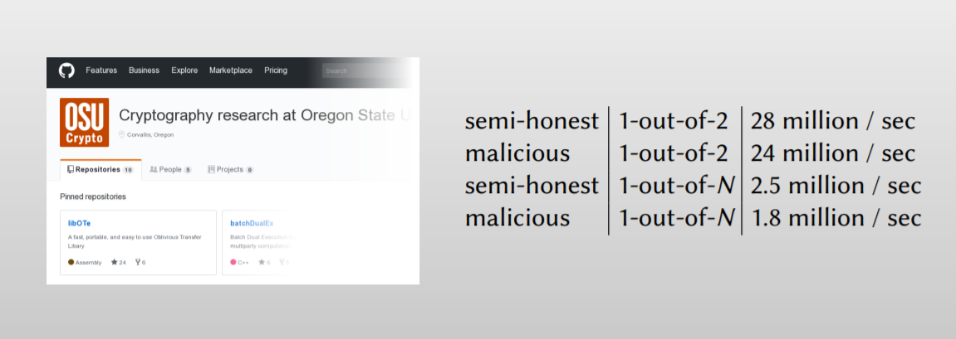
Perspective

Slide 70
Thank you!!

